Slide 1

Allife Bank
Personal Loan Acceptance Predictor

Slide 2
Table of contents
01
02
03
Problem Overview
Data Description & Preparation
Data
Visualization
04
05
Model Building
Business Insights

Slide 3

Mission statement
Problem Overview
01
AllLife Bank is a US bank that has a growing customer base.
The majority of customers = liability customers
With varying sizes of deposits.
Not as many customers who are borrowers (asset customers)
Bank wants to grow asset customers
Earn more through the interest on loans.
PROBLEM STATEMENT:
To identify factors that influence customers'
acceptance of personal loans and develop a predictive model to target potential loan customers.

Slide 4
Chosen Data Set
Bank Personal Loan Modelling:
Source:
Obtained from Kaggle https://www.kaggle.com/datasets/mahdinavaei/bankpersonalloanmodelling
5000 Rows
14 Columns

Slide 5
The Variables
Level1: Undergraduate
2: Graduate
3: Advanced
CUSTOMER ID
Customer Unique ID
EDUCATION
AGE
Customer’s
age
MORTGAGE
Value of house mortgage if any.(In thousand $)
EXPERIENCE
Years Professional Experience
PERSONAL LOAN
0: Customer did not accept loan
1: Customer accepted
INCOME
Customer Annual Income (in thousand $)
SECURITIES ACCOUNT
0: Customer does not have securities account. 1: Customer has Securities account
ZIP CODE
Home address ZIP Code
CD ACCOUNT
No Description
FAMILY
Customer Family Size
ONLINE
No Description
Average monthly credit card spending
(in thousand $)
0: Customer doesn’t have credit card
1: Customer has credit card
CC AVG
CREDIT CARD

Slide 6
The Variables
Level1: Undergraduate
2: Graduate
3: Advanced
CUSTOMER ID
Customer Unique ID
EDUCATION
AGE
Customer’s
age
MORTGAGE
Value of house mortgage if any.(In thousand $)
EXPERIENCE
Years Professional Experience
PERSONAL LOAN
0: Customer did not accept loan
1: Customer accepted
INCOME
Customer Annual Income (in thousand $)
SECURITIES ACCOUNT
0: Customer does not have securities account. 1: Customer has Securities account
ZIP CODE
Home address ZIP Code
CD ACCOUNT
No Description
FAMILY
Customer Family Size
ONLINE
No Description
Average monthly credit card spending
(in thousand $)
0: Customer doesn’t have credit card
1: Customer has credit card
CC AVG
CREDIT CARD

Slide 7
Data Preparation
02
Variables to remove
Check for impossible values
Check for NA, missing values, duplicate variables
Categorical Variables:
Customer ID
ZIP Code
Unclear Variables:
CD Account
Online
Took a summary of the dataset:
“Experience” variable has negative values.
Removed them
None

Slide 8
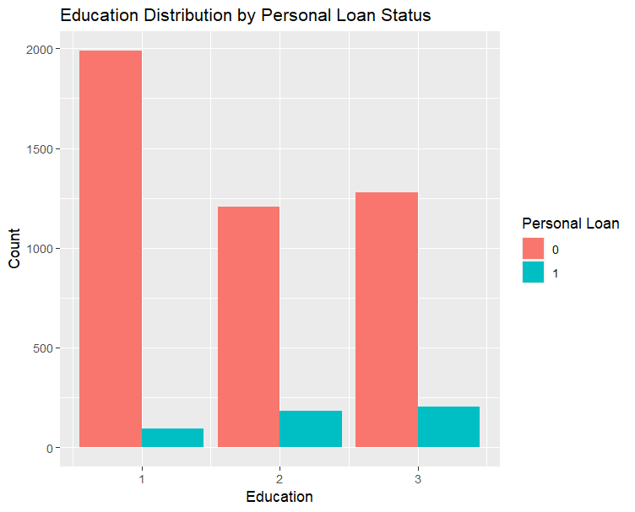
Less Education → More chance of not accepting the loan
More Education → Higher chance of accepting the loan
Data Visualization: Education
03
Notes:
Reason is probably because the customer will be in a more stable financial position if they have a higher level of education.

Slide 9
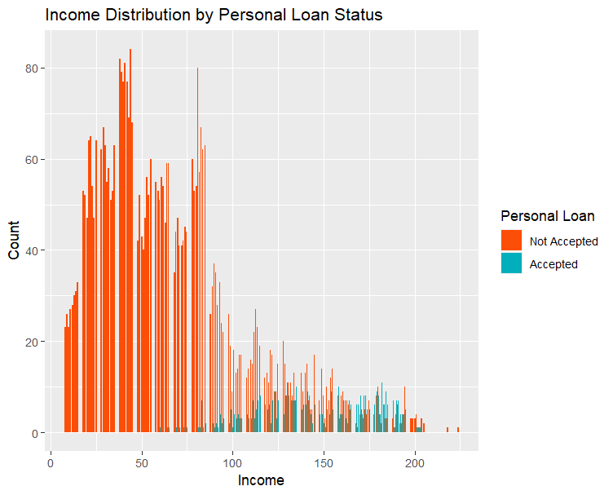
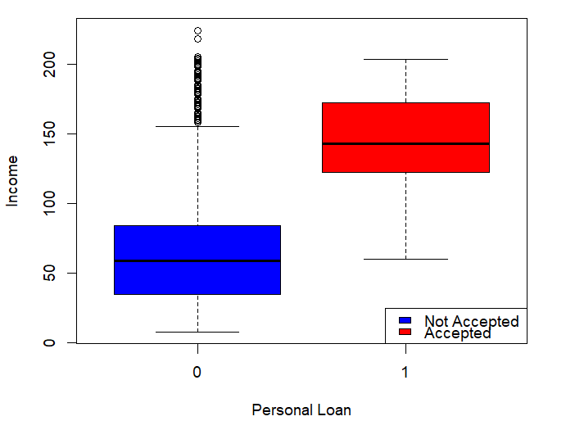
Lower Income Customers
More likely to NOT accept
Could be offered higher interest rates
Higher income more likely to accept:
Greater ability to repay loan
Higher Credit Score
Data Visualization: Income
03
Notes:
Reason is probably because the customer will be in a more stable financial position if they have a higher level of education.

Slide 10
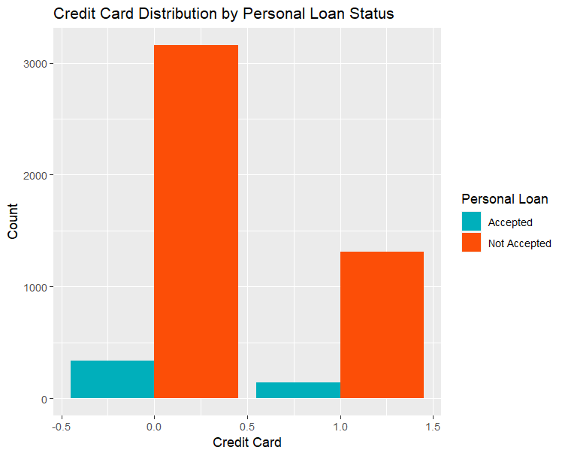
Customers with NO credit card
More likely to NOT accept
Perhaps not as interested in borrowing money
Credit Card Holders:
Higher Credit Score
Lower interest rate offer
Data Visualization: Credit Card Holders
03
Notes:
Reason is probably because the customer will be in a more stable financial position if they have a higher level of education.

Slide 11
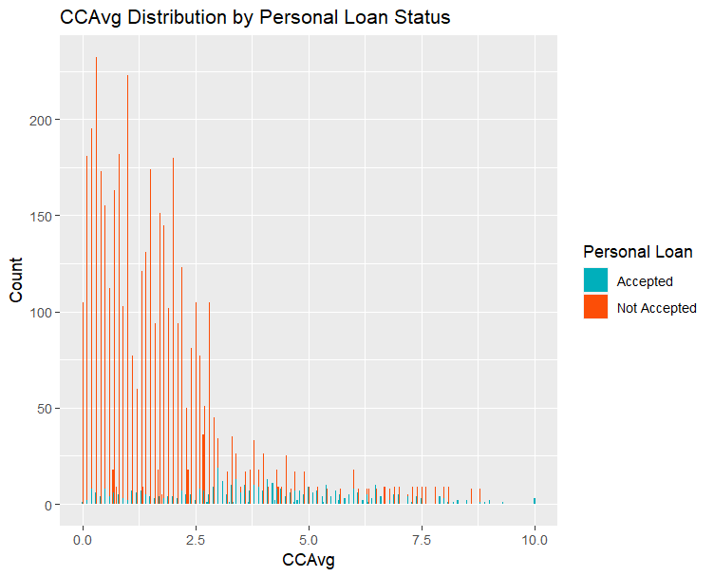
Customers that do not accept
Have a lower CC Avg
Those the accept:
Spread out distribution
No conclusion
Data Visualization: Credit Card Average Spending
03
Notes:
Reason is probably because the customer will be in a more stable financial position if they have a higher level of education.

Slide 12
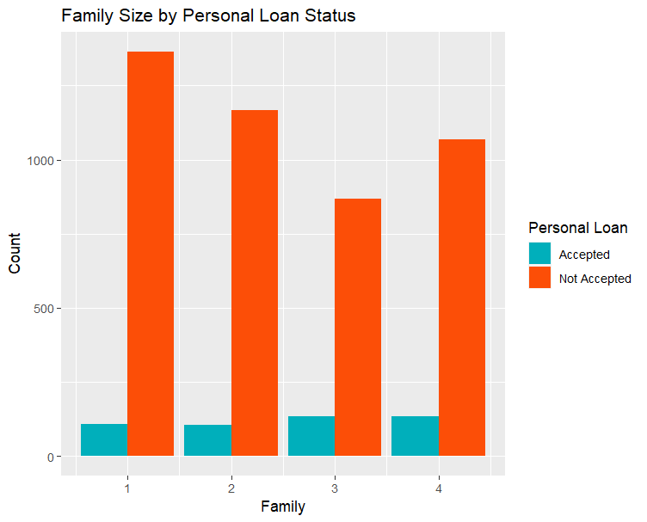
Families of larger size have a slightly higher chance of accepting the loan.
But the number of those who do not accept doesn’t follow a trend
Data Visualization: Family Size
03
Notes:
Reason is probably because the customer will be in a more stable financial position if they have a higher level of education.

Slide 13
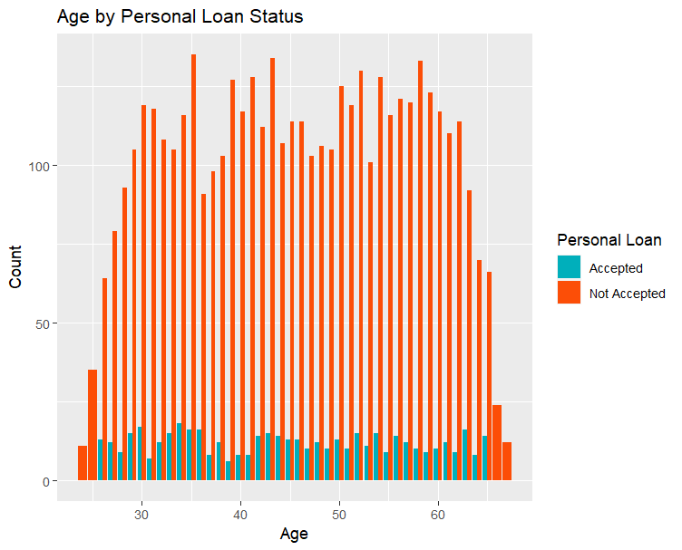
No significant difference in distribution
Data Visualization: Age
Notes:
Reason is probably because the customer will be in a more stable financial position if they have a higher level of education.

Slide 14
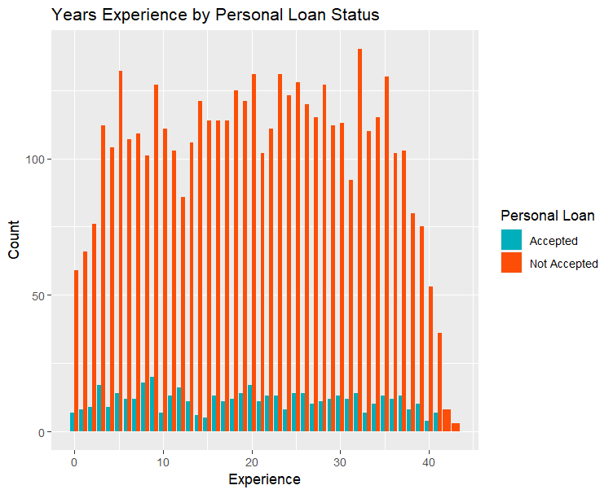
No significant difference in distribution
Data Visualization: Experience
Notes:
Reason is probably because the customer will be in a more stable financial position if they have a higher level of education.

Slide 15
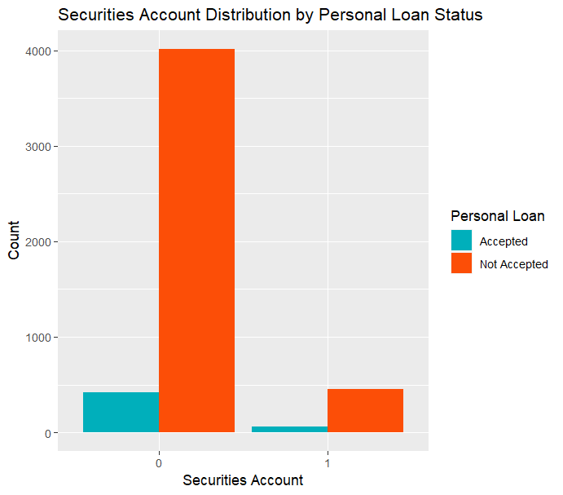
Inconclusive results
Not a significant predictor for personal loan acceptance
Won’t be including in the model building
Data Visualization: Securities Account
Notes:
Reason is probably because the customer will be in a more stable financial position if they have a higher level of education.

Slide 16
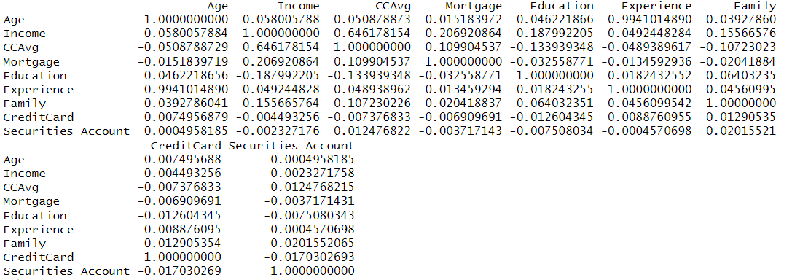
Age & Experience
High Correlation
Remove Age
Securities Account
Not relevant
Removed
Model Preparation: Correlation
Notes:
Reason is probably because the customer will be in a more stable financial position if they have a higher level of education.

Slide 17
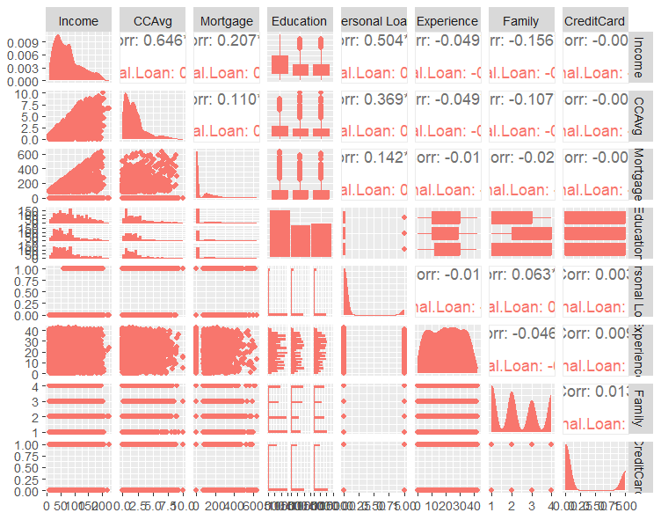
No concerns for MULTICOLLINEARITY
Model Preparation: Correlation
Model Preparation: Correlation
Notes:
Reason is probably because the customer will be in a more stable financial position if they have a higher level of education.

Slide 18
Model Building: Logistic Regression
04
Binary Classifier Model (Accepted or Not Accepted)
Binomial Distribution: assume response follows Bernoulli distribution
Simple to execute
Performs well with categorical (binary) predictor variables and numeric (we have both)

Slide 19
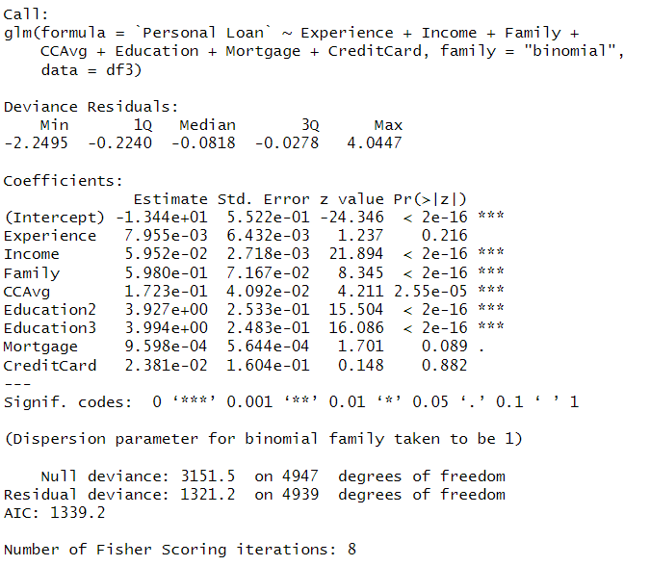
Model Building: Logistic Regression
04
CreditCard has a high p value
Not statistically significant for predicting Personal Loan acceptance
Mortgage & Experience removed

Slide 20
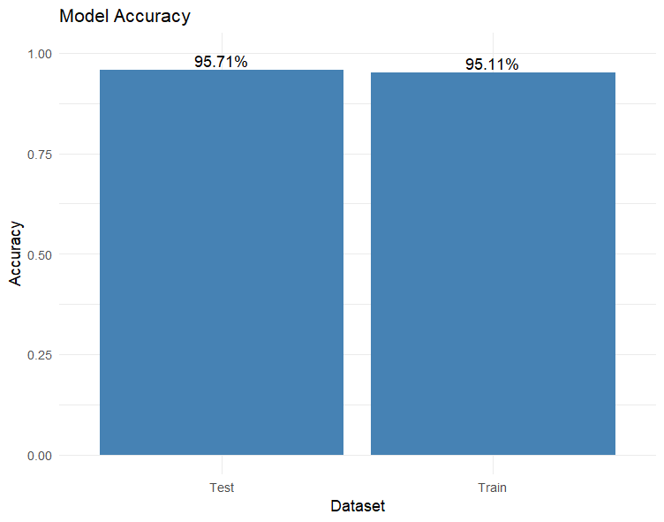
Model Building: Logistic Regression
04
No Overfitting!
Final Variables included:
Income
Family
CCAvg
Education
Split data → 60% training, 40% test

Slide 21
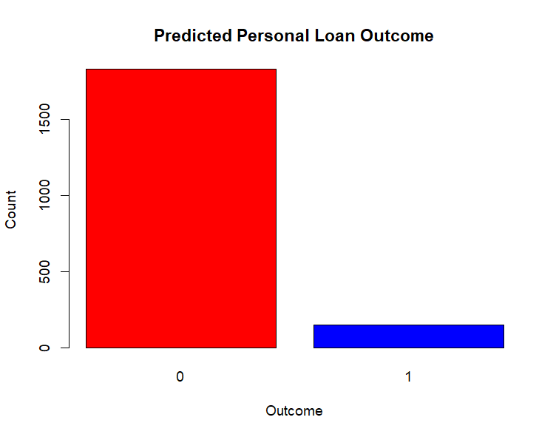
Model Building: Logistic Regression
04
Class Imbalance
Let’s predict a customer:
Income: 80000
Family: 3
CCAVG : 2
Education: 1
This customer was predicted to ACCEPT the loan offer

Slide 22
Model Building: Logistic Regression
04
Cross Validation: for Real-World Use
Accuracy: 95.41%
Kappa: 0.7068
The high accuracy and substantial agreement show:
The model is able to capture meaningful patterns in the data and make accurate predictions.

Slide 23
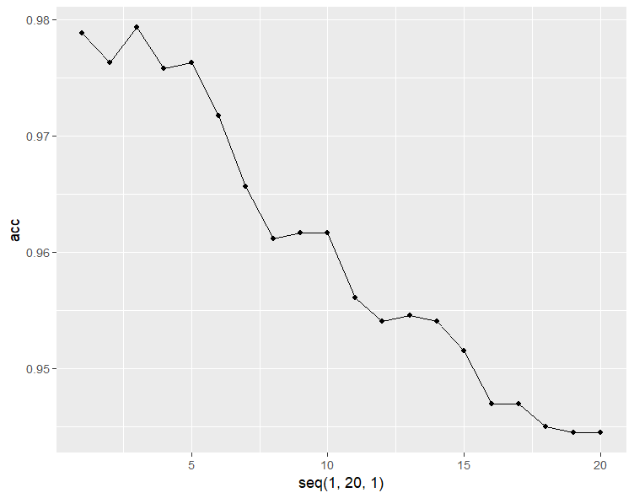
Model Building: KNN Model
04
Step1 : Normalize the data
Variables included:
Income, Family, CCAvg
Step2 : Find the best K value where accuracy is maximized
K = 3
97.92% Accuracy!

Slide 24
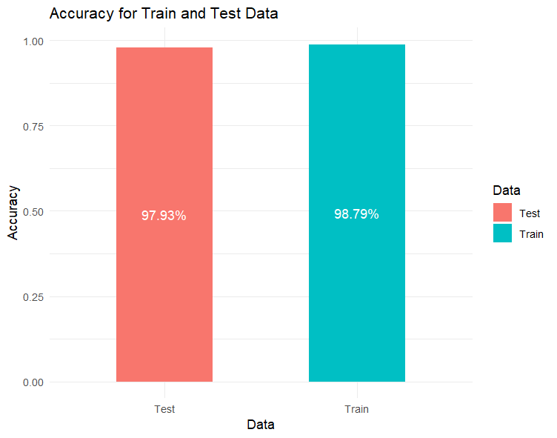
Model Building: KNN Model
04
Accuracy for training data is significantly HIGHER than test.
Model is possibly overfitting the training data

Slide 25
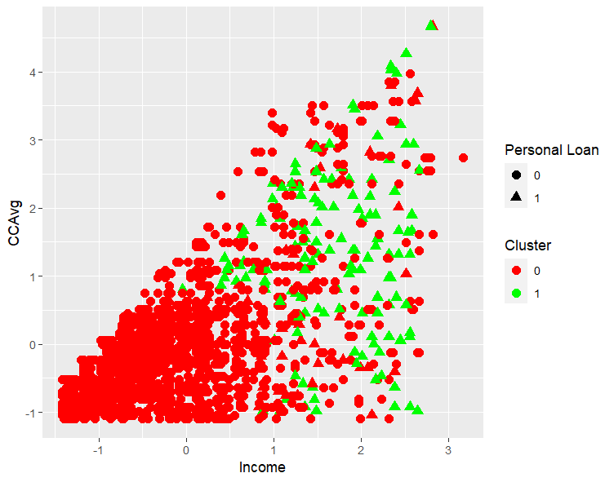
With k =3
2 clusters are formed.
Cluster 0: Lower Income, Lower average CC spending → More likely to NOT accept Loan
Cluster 1: Higher Income, Higher CCAvg → More likely to ACCEPT loan

Slide 26

Model: Suggestion
04
Although the KNN model had a higher overall accuracy, it was overfitting the data slightly.
We suggest the company implements the Logistic Regression Model

Slide 27
Business Insights & Recommendations
05
Identification of Key Factors
Risk Assessment
Customer Segmentation
Product Development & Offerings
Predictive Model
Marketing Strategy Optimization

